Slide 1
PROPERTIES OF MINIMUM STEINER TREES

Slide 2
Given a graph and a subset of vertices in the graph, a Steiner tree spans through the given subset.
The Steiner Tree may contain some vertices which are not in given subset but are used to connect the vertices of subset.
The Steiner Tree Problem is to find the minimum cost Steiner Tree.
If given subset (or terminal) vertices is equal to set of all vertices in Steiner Tree problem, then the problem becomes Minimum Spanning Tree problem. And if the given subset contains only two vertices, then it shortest path problem between two vertices.
Minimum Steiner Tree problem is NP Hard.
Exactly three edges at every Steiner vertex.
The angles between the edges meeting at a Steiner vertex is 120 degrees.
If there are N vertices then we can use a maximum of N-2 Steiner vertices.

Slide 3
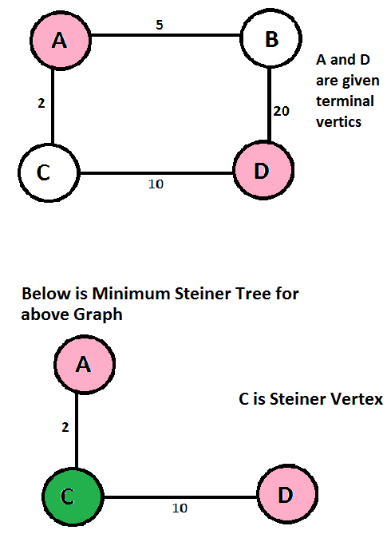

Slide 4
SHORTEST PATH BASED
APPROXIMATE ALGORITHM
TO SOLVE STEINER TREE PROBLEM

Slide 5
Since Steiner Tree problem is NP-Hard, there are no polynomial time solutions that always give optimal cost. Therefore, there are approximate algorithms to solve the same. Below is one simple approximate algorithm.
Start with a subtree T consisting of one given terminal vertex
While T does not span all terminals
Select a terminal x not in T that is closest to a vertex in T.
Add to T the shortest path that connects x with T
The above algorithm is (2-2/n) approximate, i.e., it guarantees that solution produced by this algorithm is not more than this ratio of optimized solution for a given graph with n vertices. There are better algorithms also that provide better ratio.

